Slide 1
High On Data
A project proposed by Data Science Club at Indiana University to tackle the ongoing opioid crisis
DATA SCIENCE CLUB
Notes:
We are the representatives of dsc at IU and we're proposing a project which is a data science solution to tackle the ongoing opioid crisis.

Slide 2
About Data Science Club
DSC is a student body of around 150+ active members with close to 250+ Alumni.
Our mission is to create a Data Science Community here at IU by providing students with opportunities in data science.
Our vision is to help our students and faculties come together to share knowledge and establish an environment for any data science related activity like workshops, mentorship, projects etc
DATA SCIENCE CLUB
Notes:
We would like to bring forward the increasing cases of Opioid addiction and its massive effects on almost all the age groups.

Slide 3
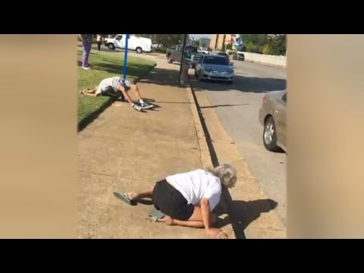
The Problem!
DATA SCIENCE CLUB
Notes:
So as we can see this is one such case of overdosing over the millions that happen. When we dug in to find out more information about this we found some devastating statistics

Slide 4
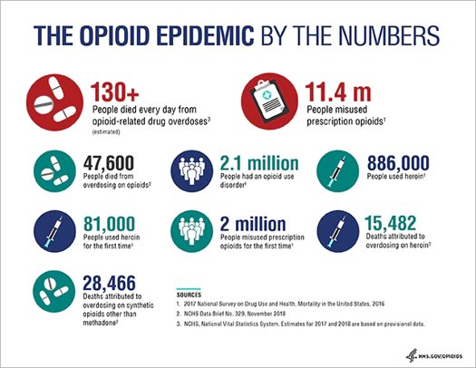
About the Opioid Crisis
DATA SCIENCE CLUB
Notes:
This motivated us to think of a solution to help curb this ongoing crisis. And what better
This is a real problem that needs to be solved. And being from DSC we naturally thought let's use data science to help curb the ongoing crisis

Slide 5
Shortcomings of current Data Science solutions to tackle the CRisis
No real time analysis​
Low interpretability​
Lack of publicly available relevant data
DATA SCIENCE CLUB
Notes:
1. Most of the Data Science/ Statistical work on drug related is on stationary data and thus the results gets outdated as new data comes, requiring repeat expenditure to run the analysis back on the updated data. There is no option to run the analysis in real time and no facility for custom analysis.
2. Advanced Machine algorithms can give very high predictive and forecasting accuracy, however are like black boxes with little or no interpretability. For example, we can accurately predict the probability of a person being addicted to prescription drugs, but do we know what factors influence this event? Hence there are limitations for recommendations from data being used for preventive action.
3. Lastly there is the problem of lack of good quality data. Surveys need huge time and economical resources, and are often representative of only a limited geographical region or demographic, making it difficult to generalize on what we learn from the analysis.
Big pharameceutical companies usually have the access to most of the good quality drug data but that's almost always confidential.

Slide 6
Solution Proposed!
DEMO
An easy to use end-to-end application to perform analysis on drug related datasets.​
User will get to wear the hat of "Data Scientist" and perform his own analysis.​
Utilize Twitter and other publicly available data ​
Research and development of cutting-edge algorithms( Twitter sentiment analysis, Natural Language Processing and advanced inferential concepts) to achieve the said tasks.
DATA SCIENCE CLUB
Notes:
1. As opposed to classical statistical analysis, recent Data Science algorithms have proven to be much more accurate for prediction, however it creates a notion that a very sound technical background and training is required to make use of said algorithms. We plan to build an end-to-end application t users of our app will be able to run these algorithms with a single click.
Drug enforcement analysts and researchers, who are our target users will get to wear the hat of "Data Scientists" and will have at their disposal state of the art data science models.
2. Another functionality of the application will be "model interpretability", to unravel the blackbox that is an advanced Machine Learning algorithm
3. Finally the app will have the functionality of scraping and analyzing social media data. For starters, we can scrape tweets from a particular geograpahic location and predict the proababilty of someone being addicted to prescription drugs, and then find demographic hotspots where higher rate of addicts are found.

Slide 7
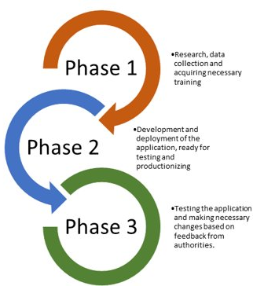
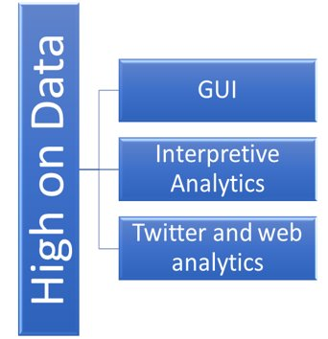
DATA SCIENCE CLUB
Notes:
1. Our project has 3 main domains as shown – a GUI, an Interpretive Analytics framework and Social media Analytics and we will follow them for division of work.
2. Additionally work will be carried out in 3 phases as mentioned simultaneously for the 3 domains( spread out over time period equivalent to 1 academic semester), which gives us room not only for technical innovation but also validate our work on real life scenario

Slide 8
Total Expected: $2000
Budget Requirements
$500
Technical Infrastructure​
$1500
Work hours ( approximately $10-15 per hour)
Premium Twitter account​
Web Hosting​
Deployment on cloud
DATA SCIENCE CLUB
Notes:
1. We need to deploy the application for global accessibility, hence would need be in the form of a web app. Infrastructure costs will be incurred to host the app on a domain with cloud comupting to enable to run the high compuational analytics.
2. We plan to have three 2-member teams working on the project for each of the three domains and require a maximum of $1000 worth of work hours from them in order to be able to complete the project successfully.

Slide 9
References:
https://www.drugabuse.gov/drugs-abuse/opioids/opioid-overdose-crisis
https://www.hhs.gov/opioids/
https://healthitanalytics.com/news/fda-data-analytics-new-policies-will-curb-opioid-abuse-in-2019
https://developer.twitter.com/en/premium-apis.html
DATA SCIENCE CLUB
Notes:
1. We need to deploy the application for global accessibility, hence would need be in the form of a web app. Infrastructure costs will be incurred to host the app on a domain with cloud comupting to enable to run the high compuational analytics.
2. We plan to have three 2-member teams working on the project for each of the three domains and require a maximum of $1000 worth of work hours from them in order to be able to complete the project successfully.

Slide 10
We are now open to questions...
DATA SCIENCE CLUB
Notes:
1. We need to deploy the application for global accessibility, hence would need be in the form of a web app. Infrastructure costs will be incurred to host the app on a domain with cloud comupting to enable to run the high compuational analytics.
2. We plan to have three 2-member teams working on the project for each of the three domains and require a maximum of $1000 worth of work hours from them in order to be able to complete the project successfully.

